Slide 1
Block Ciphers
Dr. Md. Mahbubur Rahman

Slide 2
Introduction
Many symmetric block encryption algorithms in current use are based on a structure referred to as a Feistel block cipher
For that reason, it is important to examine the design principles of the Feistel cipher.
A comparison of stream ciphers and block ciphers will be made

Slide 3
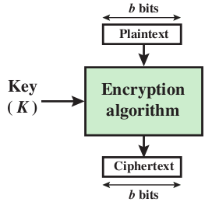
Block Ciphers
Encrypt a block of plaintext as a whole to produce same sized cipher text
Typical block sizes are 64 or 128 bits
As with a stream cipher, the two users share a symmetric encryption key
Using some modes of operation block cipher can be used to achieve the same effect as a stream cipher.
applicable to a broader range of
applications than stream ciphers.
Block cipher

Slide 4
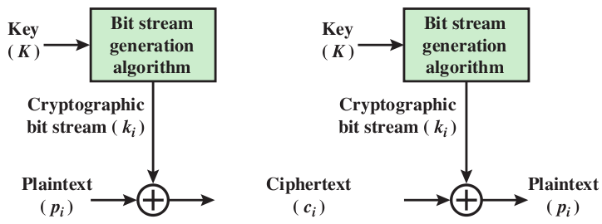
Stream Ciphers
Encrypts a digital data stream one bit or one byte at a time
One time pad is example; but has practical limitations
Typical approach for stream cipher:
Key (K) used as input to bit-stream generator algorithm
Algorithm generates cryptographic bit stream (k_{i} ) used to encrypt plaintext
Users share a key; use it to generate keystream
Stream cipher using algorithmic
bit-stream generator
Notes:
Block ciphers work a on block / word at a time, which is some number of bits. All of these bits have to be available before the block can be processed. Stream ciphers work on a bit or byte of the message at a time, hence process it as a “stream”. Block ciphers are currently better analysed, and seem to have a broader range of applications, hence focus on them.

Slide 5
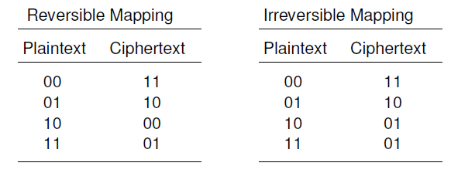
Motivation for the Feistel Cipher Structure : Reversible and irreversible Mappings
n-bit block cipher takes n bit plaintext and produces n bit ciphertext
In n bits, 2n possible different plaintext blocks
Encryption to be reversible (i.e., for decryption to be possible), each must produce a unique ciphertext
For n = 2,
If we limit ourselves to reversible mappings, the number of different transformations is (2n)!.

Slide 6
Ideal Block Cipher
n-bit input maps to 2^{n} possible input states
Substitution used to produce 2^{n} output states
Output states map to n-bit output
Feistel refers to this as Ideal block cipher because it allows maximum number of possible encryption mappings from plaintext block
Problems with ideal block cipher:
Small block size: equivalent to classical substitution cipher; cryptanalysis based on statistical characteristics feasible
Large block size: key must be very large; performance/implementation problems

Slide 7
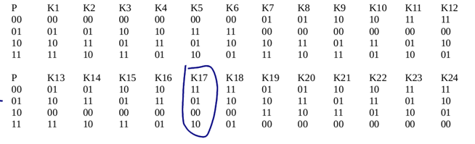
Ideal block cipher example
2 bit block, 2²=4 mappings
Input 01
Output 01 if K17 is used, as K17=11 01 00 10

Slide 8
Ideal : n-bit block, 2^{n} Mappings.
Total n. 2^{n} mappings
Any Key length (to represent any mapping) n. 2^{n} bits (each mapping contains n bits)
Fiestel: n-bit block, 2^{K} mappings, key length K

Slide 9
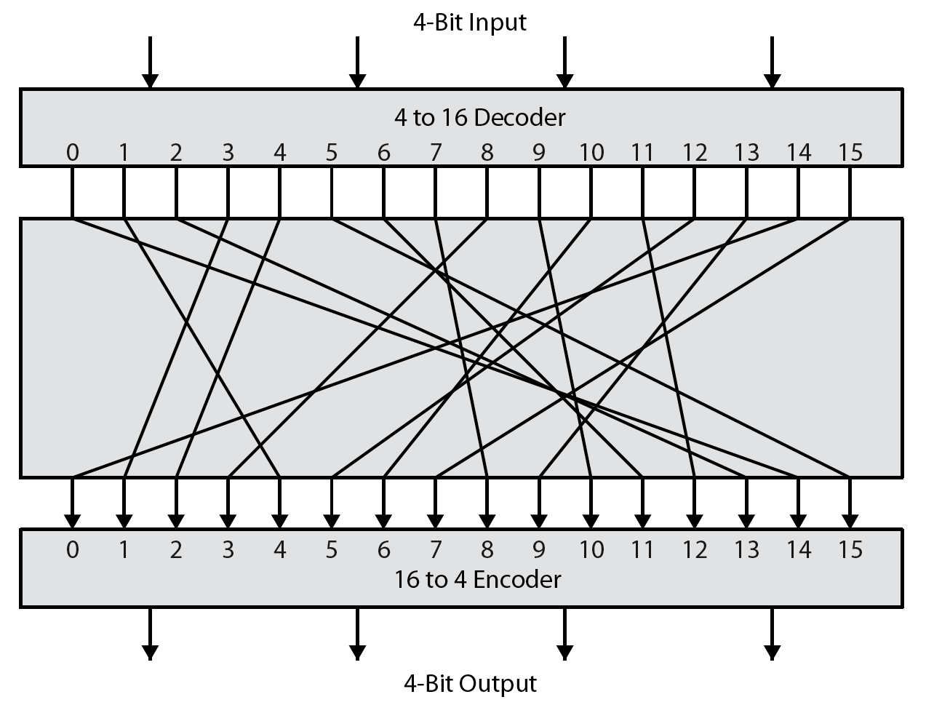
Substitution/Block cipher
4-bit input produces one of 16 input states
What is the possible number of different transformations?
which is mapped by the substitution cipher into a unique one of 16 possible output states, each of which is represented by 4 ciphertext bits.
This is the most general form of block cipher and can be used to define any reversible mapping between plaintext and ciphertext.
Figure illustrates the logic of a general substitution cipher for n = 4.

Slide 10
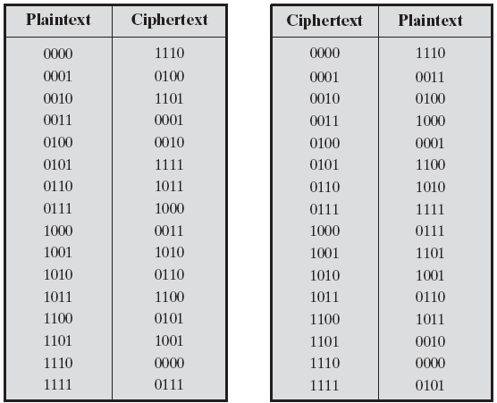
Encryption and Decryption Tables for Substitution Cipher

Slide 11
Substitution-permutation (S-P) networks
Claude Shannon and Substitution-Permutation Ciphers
Claude Shannon introduced idea of substitution-permutation (S-P) networks in 1949 paper
This idea is the basis of modern block ciphers
S-P nets are based on the two primitive cryptographic operations seen before:
substitution (S-box)
permutation (P-box)
Provide confusion & diffusion of message & key

Slide 12
Diffusion and Confusion
Diffusion
Dissipates statistical structure of plaintext over bulk of ciphertext
E.g. A plaintext letter affects the value of many ciphertext letters
How: repeatedly apply permutation (transposition) to data, and then apply function
Confusion
Makes relationship between ciphertext and key as complex as possible
Even if attacker can find some statistical characteristics of ciphertext, still hard to find key
How: apply complex (non-linear) substitution algorithm

Slide 13

Diffusion
How to achieve this?
Develop a many-to-many mapping between plain-ciphertext
Having each plaintext digit affect the value of many ciphertext digits; generally
this is equivalent to having each ciphertext digit be affected by many plaintext digits.
An example: encrypt a message of characters with an averaging operation:
adding k successive letters to get a ciphertext letter y_{n}.
One can show that the statistical structure of the plaintext has been dissipated

Slide 14
Confusion
How to achieve this?
Achieved by the use of a complex substitution algorithm.
In contrast, a simple linear substitution function would add little confusion.

Slide 15
Components of a Modern Block Cipher
Modern block ciphers normally are keyed substitution ciphers in which the key allows only partial mappings from the possible inputs to the possible outputs.
P-Boxes
A P-box (permutation box) parallels the traditional transposition cipher for characters. It transposes bits.

Slide 16
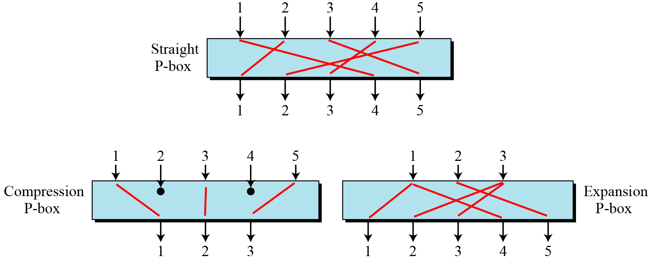
Continued
Three types of P-boxes

Slide 17
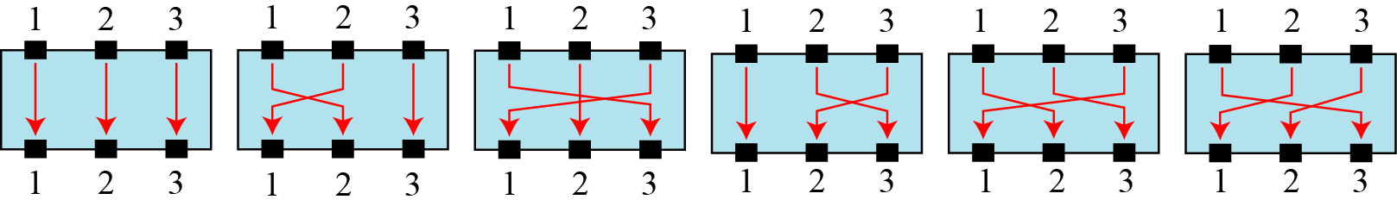
Continued
Example
Figure shows all 6 possible mappings of a 3 × 3 P-box.
The possible mappings of a 3 × 3 P-box

Slide 18
Continued
Straight P-Boxes
Example of a permutation table for a straight P-box

Slide 19
Continued
Example
Design an 8 × 8 permutation table for a straight P-box that moves the two middle bits (bits 4 and 5) in the input word to the two ends (bits 1 and 8) in the output words. Relative positions of other bits should not be changed.
Solution
We need a straight P-box with the table [4 1 2 3 6 7 8 5]. The relative positions of input bits 1, 2, 3, 6, 7, and 8 have not been changed, but the first output takes the fourth input and the eighth output takes the fifth input.

Slide 20
Continued
Compression P-Boxes
A compression P-box is a P-box with n inputs and m outputs where m < n.
Table Example of a 32 × 24 permutation table

Slide 21
Expansion P-Box
Continued
An expansion P-box is a P-box with n inputs and m outputs where m > n.
Table Example of a 12 × 16 permutation table

Slide 22
P-Boxes: Invertibility
Continued
A straight P-box is invertible, but compression and expansion P-boxes are not.

Slide 23
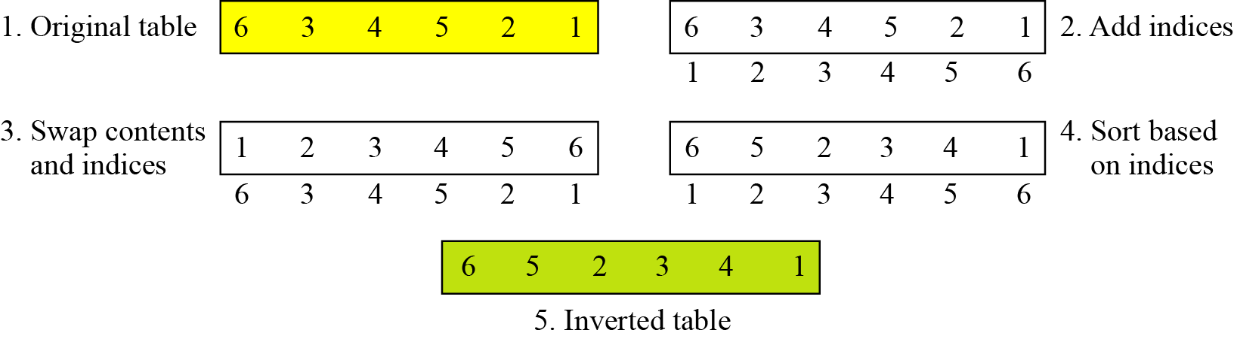
Continued
Example
Figure shows how to invert a permutation table represented as a one-dimensional table.
Figure Inverting a permutation table

Slide 24
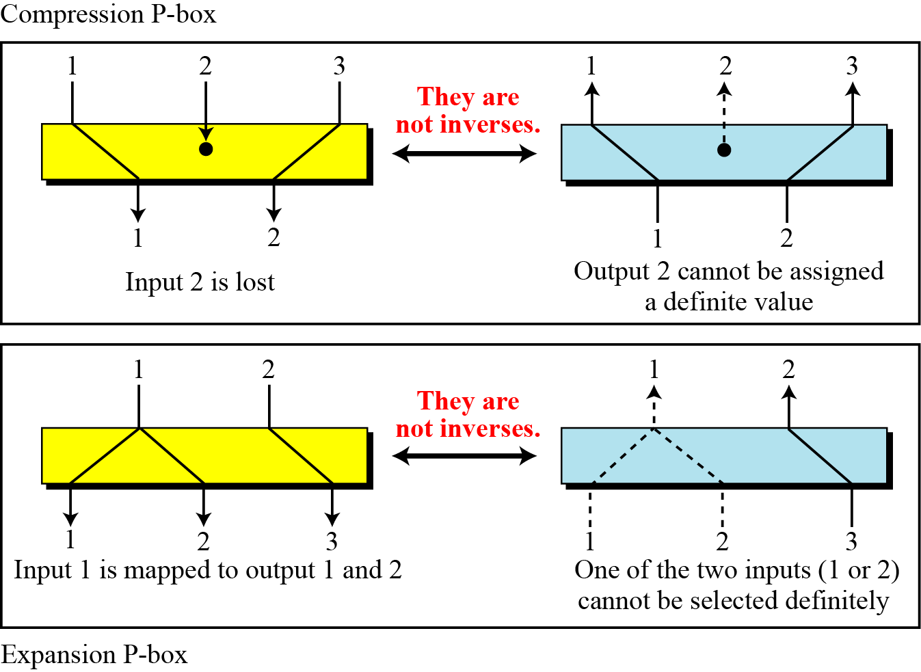
Continued
Figure Compression and expansion P-boxes are non-invertible

Slide 25
Continued
S-Box
An S-box (substitution box) can be thought of as a miniature substitution cipher.
An S-box is an m × n substitution unit, where m and n are not necessarily the same.

Slide 26
Continued
Example
In an S-box with three inputs and two outputs, we have
The S-box is linear because a_{1,1} = a_{1,2} = a_{1,3} = a_{2,1} = 1 and a_{2,2} = a_{2,3} = 0. The relationship can be represented by matrices, as shown below:

Slide 27
Continued
Example
In an S-box with three inputs and two outputs, we have
where multiplication and addition is in GF(2). The S-box is nonlinear because there is no linear relationship between the inputs and the outputs.

Slide 28
Continued
Example
The following table defines the input/output relationship for an S-box of size 3 × 2. The leftmost bit of the input defines the row; the two rightmost bits of the input define the column. The two output bits are values on the cross section of the selected row and column.
Based on the table, an input of 010 yields the output 01. An input of 101 yields the output of 00.

Slide 29
Continued
S-Boxes: Invertibility
An S-box may or may not be invertible. In an invertible S-box, the number of input bits should be the same as the number of output bits.

Slide 30
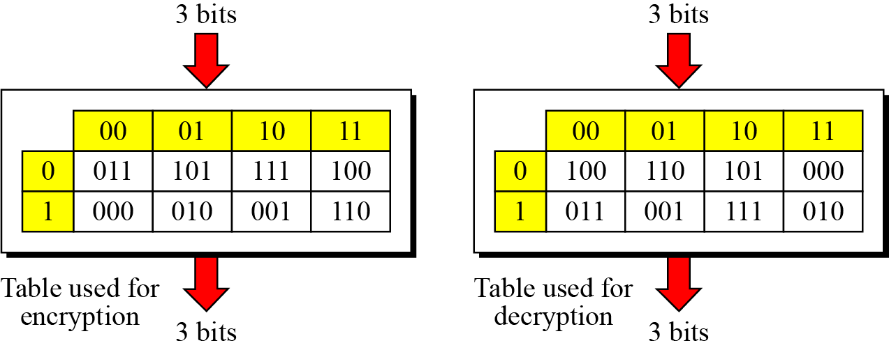
Continued
Example
Figure shows an example of an invertible S-box. For example, if the input to the left box is 001, the output is 101. The input 101 in the right table creates the output 001, which shows that the two tables are inverses of each other.
Figure S-box tables for Example

Slide 31
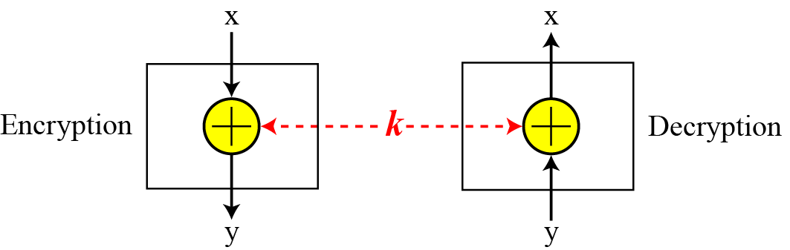
Continued
Exclusive-Or
An important component in most block ciphers is the exclusive-or operation.
Figure Invertibility of the exclusive-or operation

Slide 32
Continued
Exclusive-Or (Continued)
An important component in most block ciphers is the exclusive-or operation. Addition and subtraction operations in the GF(2^{n}) field are performed by a single operation called the exclusive-or (XOR).
The five properties of the exclusive-or operation in the GF(2^{n}) field makes this operation a very interesting component for use in a block cipher: closure, associativity, commutativity, existence of identity, and existence of inverse.

Slide 33
Continued
Exclusive-Or (Continued)
The inverse of a component in a cipher makes sense if the component represents a unary operation (one input and one output). For example, a keyless P-box or a keyless S-box can be made invertible because they have one input and one output.
An exclusive operation is a binary operation. The inverse of an exclusive-or operation can make sense only if one of the inputs is fixed (is the same in encryption and decryption). For example, if one of the inputs is the key, which normally is the same in encryption and decryption, then an exclusive-or operation is self-invertible, as shown in the Figure.

Slide 34
Continued
Figure Invertibility of the exclusive-or operation

Slide 35
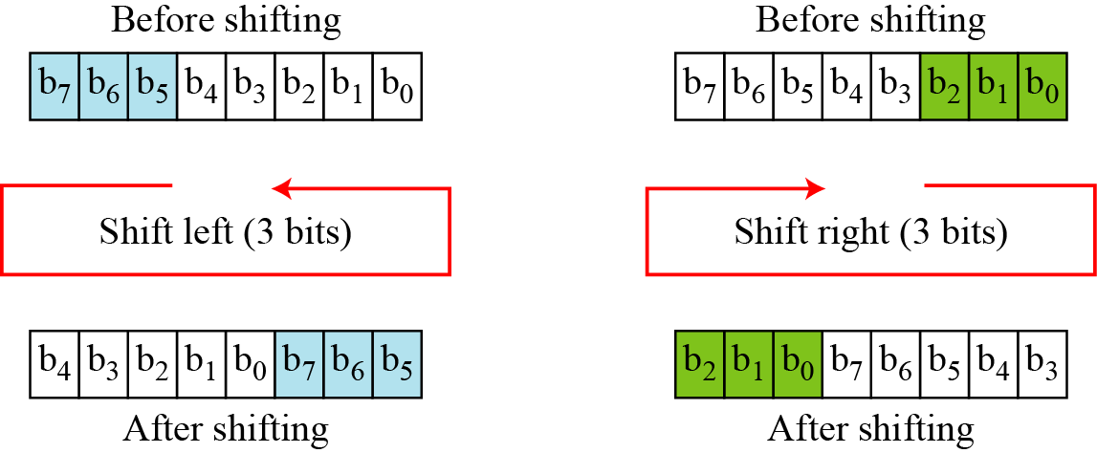
Continued
Circular Shift
Another component found in some modern block ciphers is the circular shift operation.
Figure Circular shifting an 8-bit word to the left or right

Slide 36
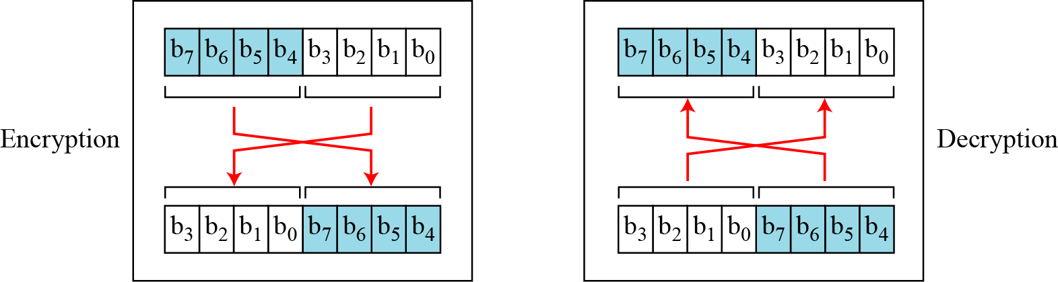
Continued
Swap
The swap operation is a special case of the circular shift operation where k = n/2.
Figure Swap operation on an 8-bit word

Slide 37
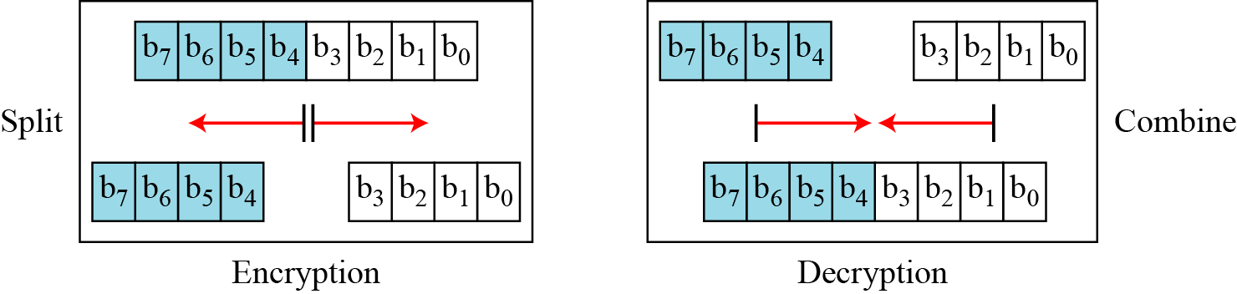
Continued
Split and Combine
Two other operations found in some block ciphers are split and combine.
Figure 5.12 Split and combine operations on an 8-bit word

Slide 38
Continued
Figure Split and combine operations on an 8-bit word

Slide 39
Product Ciphers
Shannon introduced the concept of a product cipher. A product cipher is a complex cipher combining substitution, permutation, and other components discussed in previous sections.

Slide 40
Continued
Diffusion
The idea of diffusion is to hide the relationship between the ciphertext and the plaintext.
Diffusion hides the relationship between the ciphertext and the plaintext.

Slide 41
Continued
Confusion
The idea of confusion is to hide the relationship between the ciphertext and the key.
Confusion hides the relationship between the ciphertext and the key.

Slide 42
Continued
Rounds
Diffusion and confusion can be achieved using iterated product ciphers where each iteration is a combination of S-boxes, P-boxes, and other components.

Slide 43
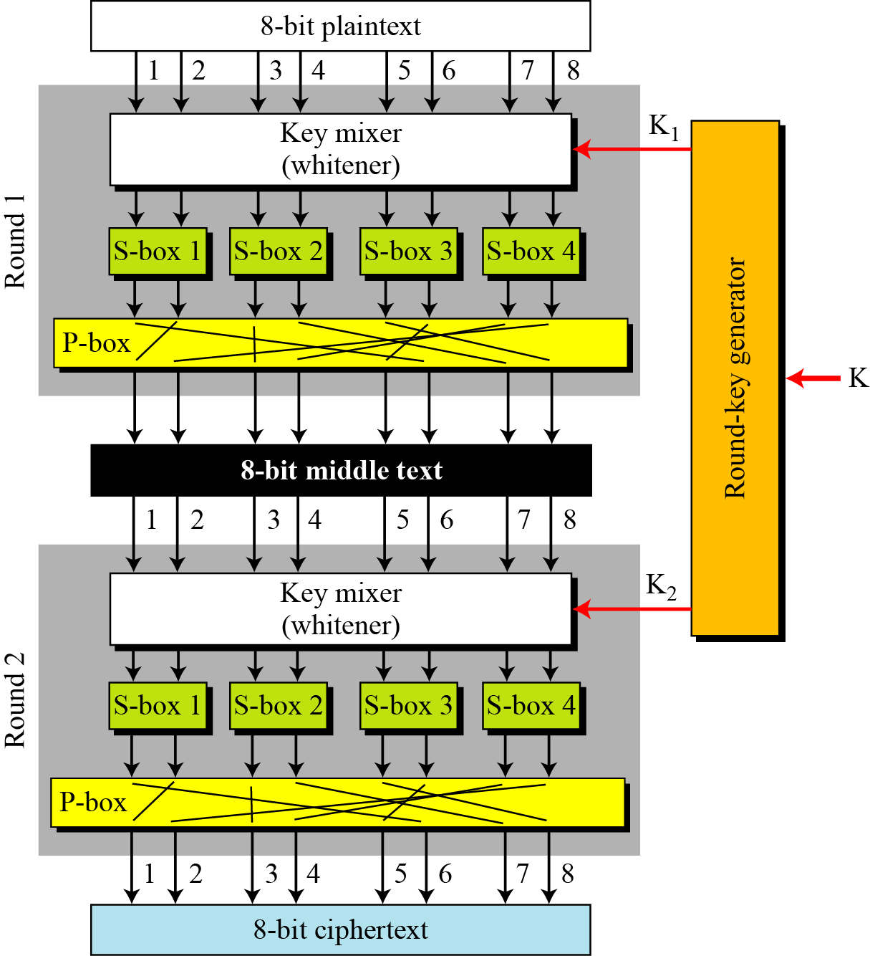
Continued
Figure A product cipher made of two rounds

Slide 44
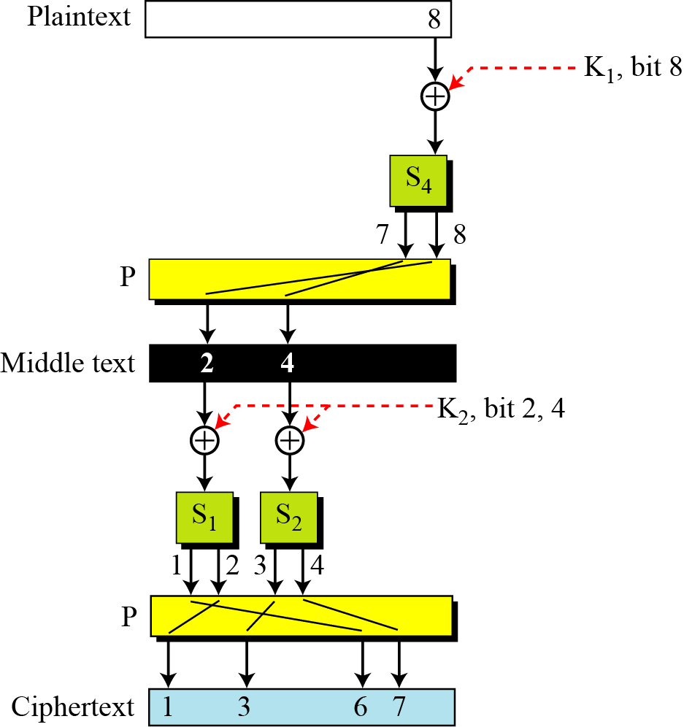
Continued
Figure Diffusion and confusion in a block cipher

Slide 45
Two Classes of Product Ciphers
Modern block ciphers are all product ciphers, but they are divided into two classes.
1. Feistel ciphers
2. Non-Feistel ciphers

Slide 46
Two Classes of Product Ciphers (cont.)
Feistel Ciphers
Feistel designed a very intelligent and interesting cipher that has been used for decades. A Feistel cipher can have three types of components: self-invertible, invertible, and noninvertible.

Slide 47
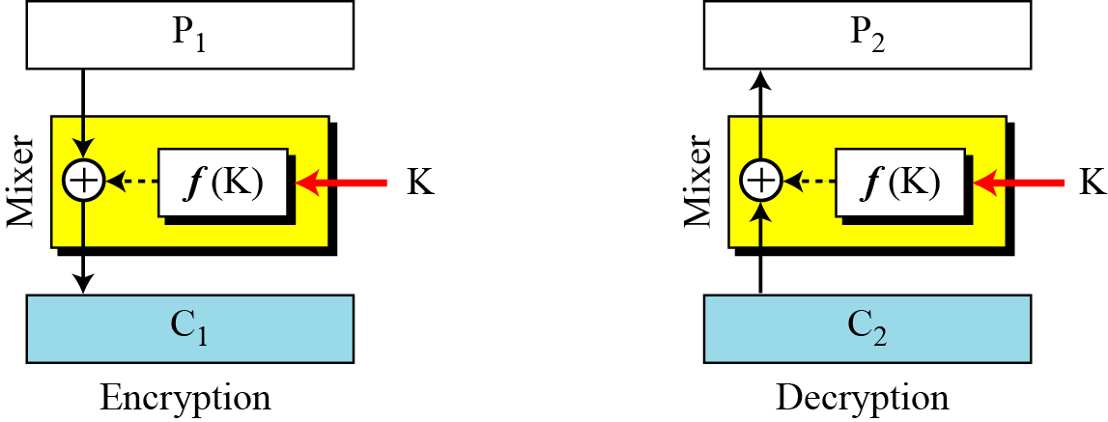
Continued
The first thought in Feistel cipher design
Non-invertible elements cancels out when X-ored
Diffusion hides the relationship between the ciphertext and the plaintext.

Slide 48


Two algorithms are inverses of each other: If C2=C1 then P2=P1

Slide 49
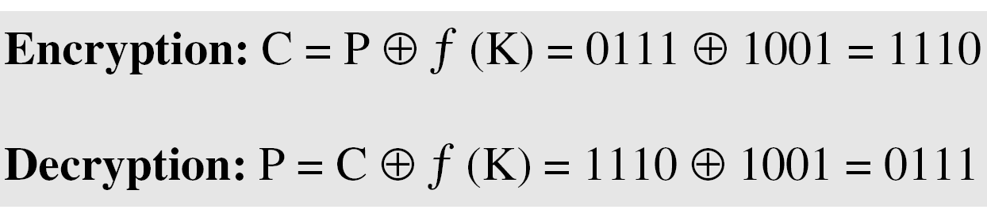
Continued
Example
This is a trivial example. The plaintext and ciphertext are each 4 bits long and the key is 3 bits long. Assume that the function takes the first and third bits of the key, interprets these two bits as a decimal number, squares the number, and interprets the result as a 4-bit binary pattern. Show the results of encryption and decryption if the original plaintext is 0111 and the key is 101.
Solution
The function extracts the first and third bits to get 11 in binary or 3 in decimal. The result of squaring is 9, which is 1001 in binary.

Slide 50
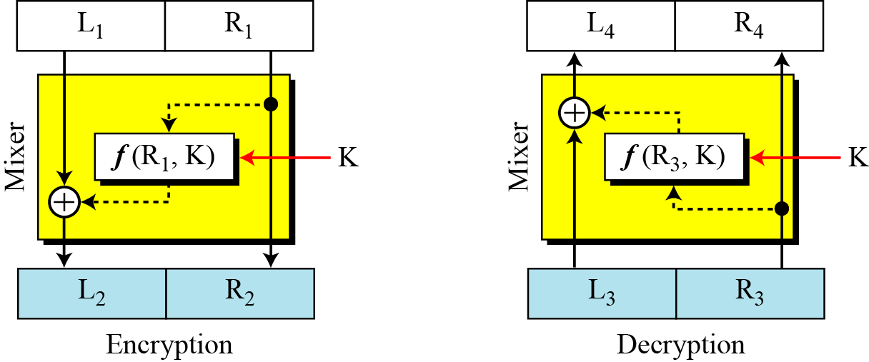
Continued
The improvement in Feistel cipher design

Slide 51

Two algorithms are inverses of each other: If L3=L2 and R3=R2

Slide 52
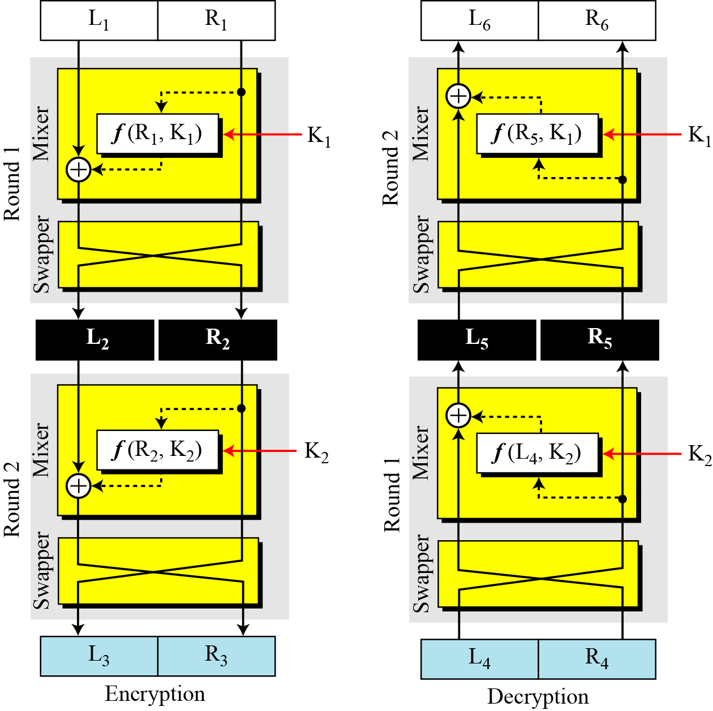
The final design of Feistel cipher
Continued
Final design Flaw: no change in Right half.
Inc: rounds
Add: swapper

Slide 53


Two algorithms are inverses of each other: If L6=L1 and R6=R1 assuming that
L4=L3 and R4=R3
Then it is easy to prove that the holds for two plaintext blocks

Slide 54
Non-Feistel Ciphers
A non-Feistel cipher uses only invertible components. A component in the encryption cipher has the corresponding component in the decryption cipher.

Slide 55
Feistel Structure for Block Ciphers
Feistel proposed applying two or more simple ciphers in sequence so final result is cryptographically stronger than component ciphers
n-bit block length; k-bit key length; 2^{k} transformations
Feistel cipher alternates: substitutions, transpositions (permutations)
Applies concepts of diffusion and confusion
Applied in many ciphers today

Slide 56
Feistel Cipher Structure
Horst Feistel devised the feistel cipher
based on concept of invertible product cipher
Partitions input block into two halves
Subkeys (or round keys) generated from key
Round function, F, applied to right half
Apply substitution on left half using XOR
Apply permutation: interchange to halves
Implements Shannon’s S-P net concept
F(RE_{i}, K_{i+1})
Notes:
Horst Feistel, working at IBM Thomas J Watson Research Labs devised a suitable invertible cipher structure in early 70's.
One of Feistel's main contributions was the invention of a suitable structure which adapted Shannon's S-P network in an easily inverted structure. It partitions input block into two halves which are processed through multiple rounds which perform a substitution on left data half, based on round function of right half & subkey, and then have permutation swapping halves. Essentially the same h/w or s/w is used for both encryption and decryption, with just a slight change in how the keys are used. One layer of S-boxes and the following P-box are used to form the round function.

Slide 57
Using the Feistel Structure
Exact implementation depends on various design features
Block size, e.g. 64, 128 bits: larger values leads to more diusion
Key size, e.g. 128 bits: larger values leads to more confusion, resistance against brute force
Number of rounds, e.g. 16 rounds
Subkey generation algorithm: should be complex
Round function F: should be complex
Other factors include fast encryption in software and ease of analysis
Trade-off: security vs. performance

Slide 58
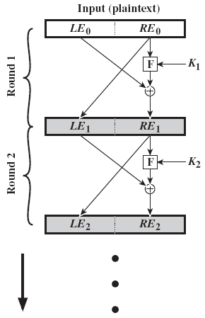
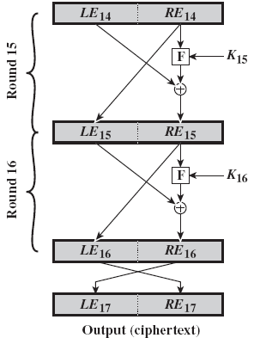
Feistel Cipher Structure Encryption
Notes:
Stallings Figure 3.3 illustrates the classical feistel cipher structure, with data split in 2 halves, processed through a number of rounds which perform a substitution on left half using output of round function on right half & key, and a permutation which swaps halves, as listed previously. The LHS side of this figure shows the flow during encryption, the RHS in decryption.
The inputs to the encryption algorithm are a plaintext block of length 2w bits and a key K. The plaintext block is divided into two halves, L₀ and R₀. The two halves of the data pass through n rounds of processing and then combine to produce the ciphertext block. Each round i has as inputs L_{i–1} and R_{i–1}, derived from the previous round, as well as a subkey K_{i}, derived from the overall K. In general, the subkeys K are different from K and from each other.
The process of decryption with a Feistel cipher is essentially the same as the encryption process. The rule is as follows: Use the ciphertext as input to the algorithm, but use the subkeys K_{i} in reverse order. That is, use K_{n} in the first round, K_{n–1} in the second round, and so on until K₁ is used in the last round. This is a nice feature because it means we need not implement two different algorithms, one for encryption and one for decryption. See discussion in text for why using the same algorithm with a reversed key order produces the correct result, noting that at every round, the intermediate value of the decryption process is equal to the corresponding value of the encryption process with the two halves of the value swapped.

Slide 59
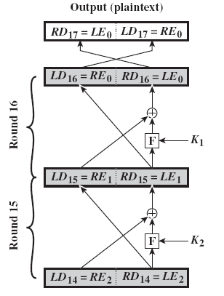
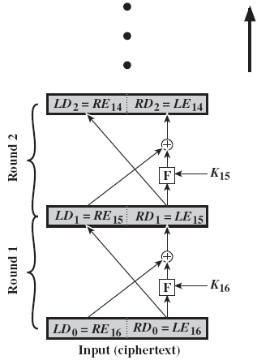
Feistel Cipher Structure Decryption

Slide 60


General Formula for Encryption/Decryption
For the ith iteration of the encryption algorithm
Rearranging terms gives the decryption:

Slide 61
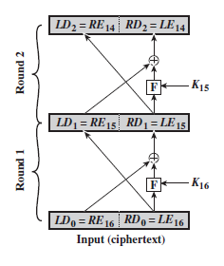

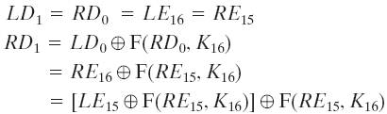
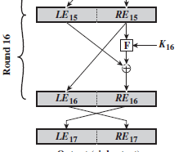
Relation between output and input
Show that the output of the first round of the
decryption process is equal to a 32-bit swap
of the input to the sixteenth round of the
encryption process.
consider the encryption
decryption side
Thus, we have
Therefore, the output of the first round
of the decryption process is , which
is the 32-bit swap of the input to the sixteenth
round of the encryption

Slide 62
Feistel Cipher Design Elements Discussions
Block size
Larger block sizes mean greater security
Key size
Larger key size means greater security but may decrease encryption/decryption speed
Number of rounds
a single round offers inadequate security but that multiple rounds offer increasing security
Notes:
The exact realization of a Feistel network depends on the choice of the following parameters and design features:
block size - increasing size improves security, but slows cipher
key size - increasing size improves security, makes exhaustive key searching harder, but may slow cipher
number of rounds - increasing number improves security, but slows cipher
subkey generation algorithm - greater complexity can make analysis harder, but slows cipher
round function - greater complexity can make analysis harder, but slows cipher
fast software en/decryption - more recent concern for practical use
ease of analysis - for easier validation & testing of strength

Slide 63
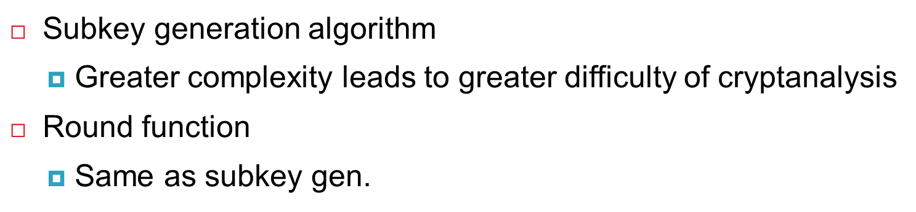
Feistel Cipher Design Elements Discussions
Notes:
The exact realization of a Feistel network depends on the choice of the following parameters and design features:
block size - increasing size improves security, but slows cipher
key size - increasing size improves security, makes exhaustive key searching harder, but may slow cipher
number of rounds - increasing number improves security, but slows cipher
subkey generation algorithm - greater complexity can make analysis harder, but slows cipher
round function - greater complexity can make analysis harder, but slows cipher
fast software en/decryption - more recent concern for practical use
ease of analysis - for easier validation & testing of strength

Slide 64
Feistel Cipher Design Elements Discussions
Fast software en/decryption
the speed of execution of the algorithm becomes a concern
Ease of analysis
if the algorithm can be concisely and clearly explained, it is easier to analyze that algorithm for cryptanalytic vulnerabilities and therefore develop a higher level of assurance as to its strength

Slide 65
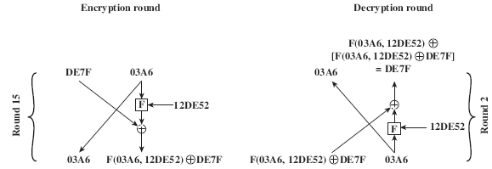
Dependency on function F
The derivation does not require that F be a reversible function.
For example, F produces a constant output (e.g., all ones) regardless of the values of its two arguments.
15th round of encryption corresponds to 2nd round of decryption
Block size is 32 bits (two 16-bit halves) and key size is 24 bits

Slide 66
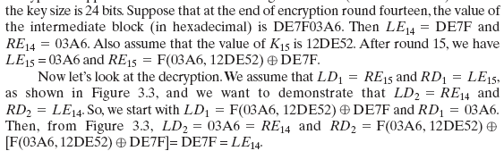
Dependency on function F

Slide 67
Symmetric Block Cipher Algorithms
DES (Data Encryption Standard)
3DES (Triple DES)
AES (Advanced Encryption Standard)

Slide 68
Data Encryption Standard
Symmetric block cipher
56-bit key, 64-bit input block, 64-bit output block
One of most used encryption systems in world
Developed in 1977 by NBS/NIST
Designed by IBM (Lucifer) with input from NSA
Principles used in other ciphers, e.g. 3DES, IDEA
Simplied DES (S-DES)
Cipher using principles of DES
Developed for education (not real world use)

Slide 69
Simplified DES
Input (plaintext) block: 8-bits
Output (ciphertext) block: 8-bits
Key: 10-bits
Rounds: 2
Round keys generated using permutations and left shifts
Encryption: initial permutation, round function, switch halves
Decryption: Same as encryption, except round keys used in opposite order

Slide 70
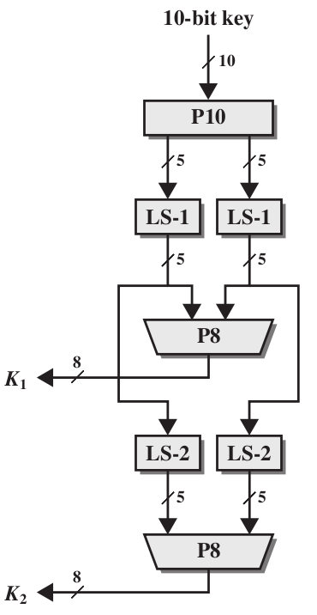
S-DES Key Generation

Slide 71
S-DES Operations
P10 (permutate)
Input : 1 2 3 4 5 6 7 8 9 10
Output: 3 5 2 7 4 10 1 9 8 6
P8 (select and permutate)
Input : 1 2 3 4 5 6 7 8 9 10
Output: 6 3 7 4 8 5 10 9
P4 (permutate)
Input : 1 2 3 4
Output: 2 4 3 1

Slide 72
Example S-DES : Key generation
Assume input 10-bit key, K, is: 1010000010
Then the steps for generating the two 8-bit round keys, K1 and K2, are:
1. Rearrange K using P10: 1000001100
2. Left shift by 1 position both the left and right halves: 00001 11000
3. Rearrange the halves with P8 to produce K1: 10100100
4. Left shift by 2 positions the left and right halves: 00100 00011
5. Rearrange the halves with P8 to produce K2: 01000011
K1 and K2 are used as inputs in the encryption and decryption stages.

Slide 73
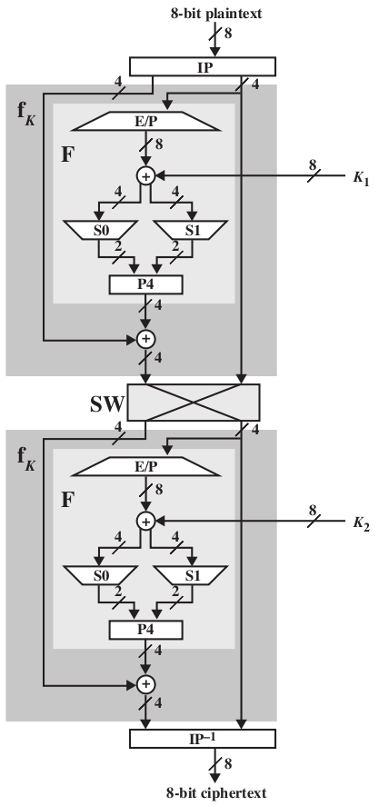
S-DES Encryption Details

Slide 74
S-DES Operations
EP (expand and permutate)
Input : 1 2 3 4
Output: 4 1 2 3 2 3 4 1
IP (initial permutation)
Input : 1 2 3 4 5 6 7 8
Output: 2 6 3 1 4 8 5 7
IP⁻¹ (inverse of IP)
LS-1 (left shift 1 position)
LS-2 (left shift 2 positions)

Slide 75
Example S-DES Encryption
Assume a 8-bit plaintext, P: 01110010
Then the steps for encryption are:
1. Apply the initial permutation, IP, on P: 10101001
2. Assume the input from step 1 is in two halves, L and R: L=1010, R=1001
3. Expand and permutate R using E/P: 11000011
4. XOR input from step 3 with K1: 10100100 XOR 11000011 = 01100111
5. Input left halve of step 4 into S-Box S0 and right halve into S-Box S1:
a. For S0: 0110 as input: b1,b4 for row, b2,b3 for column
b. Row 00, column 11 -> output is 10
c. For S1: 0111 as input:
d. Row 01, column 11 -> output is 11
6. Rearrange outputs from step 5 (1011) using P4: 0111
7. XOR output from step 6 with L from step 2: 0111 XOR 1010 = 1101

Slide 76
8. Now we have the output of step 7 as the left half and the original R as the right half. Switch the halves and move to round 2: 1001 1101
9. E/P with right half: E/P(1101) = 11101011
10. XOR output of step 9 with K2: 11101011 XOR 01000011 = 10101000
11. Input to s-boxes:
a. For S0, 1010
b. Row 10, column 01 -> output is 10
c. For S1, 1000
d. Row 10, column 00 -> output is 11
12. Rearrange output from step 11 (1011) using P4: 0111
13. XOR output of step 12 with left halve from step 8: 0111 XOR 1001 = 1110
14. Input output from step 13 and right halve from step 8 into inverse IP
a. Input us 1110 1101, b. Output is: 01110111

Slide 77
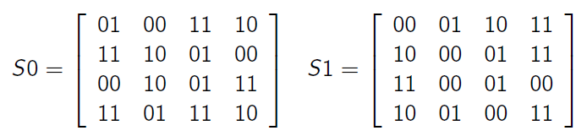
S-DES S-Boxes
S-DES (and DES) perform substitutions using S-Boxes
S-Box considered as a matrix: input used to select row/column; selected element is output
4-bit input: bit1; bit2; bit3; bit4
bit₁bit₄ species row (0, 1, 2 or 3 in decimal)
bit₂bit₃ species column
2-bit output

Slide 78
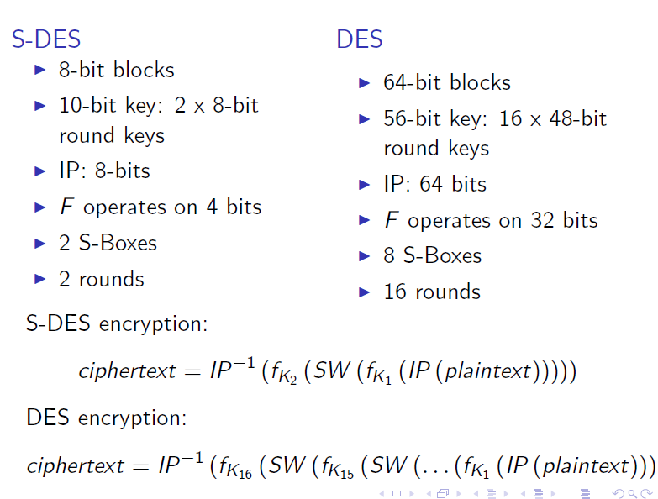
Comparing DES and S-DES

Slide 79
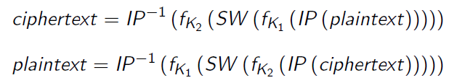
S-DES Summary
Educational encryption algorithm
S-DES expressed as functions:
Security of S-DES:
10-bit key, 1024 keys: brute force easy
If know plaintext and corresponding ciphertext, can we
determine key? Very hard

Slide 80
Data Encryption Standard (DES)
most widely used block cipher in world
adopted in 1977 by NBS (now NIST)
as FIPS PUB 46
encrypts 64-bit data using 56-bit key
has widespread use
has considerable controversy over its security

Slide 81
DES History
IBM developed Lucifer cipher
by team led by Feistel in late 60’s
used 64-bit data blocks with 128-bit key
then redeveloped as a commercial cipher with input from NSA and others
in 1973 NBS issued request for proposals for a national cipher standard
IBM submitted their revised Lucifer which was eventually accepted as the DES

Slide 82
DES Design Controversy (Concerns)
although DES standard is public, considerable controversy over design (two concerns)
in choice of 56-bit key (vs Lucifer 128-bit)
and because design criteria were classified
subsequent events and public analysis show in fact design was appropriate
use of DES has flourished
especially in financial applications
still standardised for legacy application use

Slide 83
Time to Break a DES Code (assuming 10⁶ decryptions/μs)
Using Electronic
Frontier Foundation (EFF) DES cracker
Appx 10 hrs. for DES

Slide 84
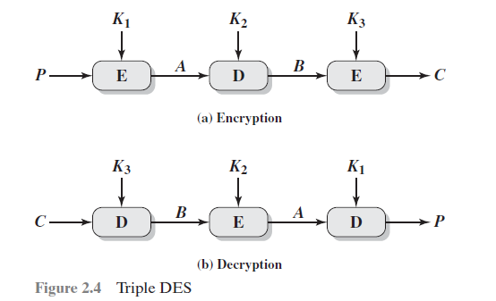
Triple DES
Triple DES (3DES) was first standardized for use in financial applications in ANSI standard X9.17 in 1985.
3DES was incorporated as part of the Data Encryption Standard in 1999 with the publication of FIPS 46-3.

Slide 85

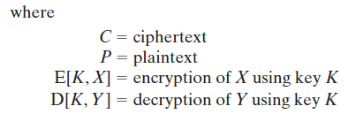

Triple DES
3DES uses three keys and three executions of the DES algorithm.The function follows an encrypt-decrypt-encrypt (EDE) sequence
There is no cryptographic significance to the use of decryption for the second stage of 3DES encryption.

Slide 86
Triple DES comments
3DES is the FIPS approved symmetric encryption algorithm of choice.
The original DES, which uses a single 56-bit key, is permitted under the standard for legacy systems only. New procurements should support 3DES.
Government organizations with legacy DES systems are encouraged to transition to 3DES.
It is anticipated that 3DES and the Advanced Encryption Standard (AES) will coexist as FIPS-approved algorithms, allowing for a gradual transition to AES.

Slide 87
Triple DES comments
FIPS: Federal Information Processing Standards
The purpose of FIPS is to ensure that all federal government and agencies adhere to the same guidelines regarding security and communication.

Slide 88
DES
For DEA, data are encrypted in 64-bit blocks using a
56-bit key.
The algorithm transforms 64-bit input in a series of steps into a 64-bit output.
The same steps, with the same key, are used to reverse the encryption.
With the exception of the initial and final permutations, DES has the exact structure of a Feistel cipher.

Slide 89
DES Encryption
As with any encryption scheme, there are two inputs to the encryption function: the plaintext to be encrypted and the key
the processing of the plaintext proceeds in three phases.
First, the 64-bit plaintext passes through an initial permutation (IP) that rearranges the bits to produce the permuted input.
2. This is followed by a phase consisting of sixteen rounds of the same function, which involves both permutation and substitution functions.
3. The left and right halves of the output are swapped to produce the preoutput.
4. Finally, the preoutput is passed through a permutation [IP ⁻¹] that is the inverse of the initial permutation function, to produce the 64-bit ciphertext.

Slide 90
Key generation
Initially, the key is passed through a permutation function.
Then, for each of the sixteen rounds, a subkey (K_{i}) is produced by the combination of a left circular shift and a permutation.

Slide 91
A DES decryption
1. As with any Feistel cipher, decryption uses the same algorithm as encryption, except that the application of the subkeys is reversed.
2. Additionally, the initial and final permutations are reversed.

Slide 92
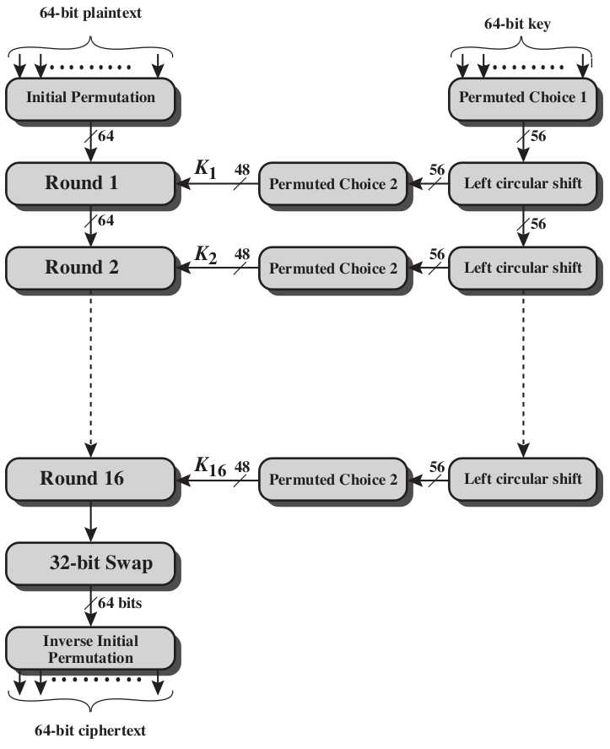
General DES Encryption Algorithm

Slide 93

DES example
For this example, the plaintext is a hexadecimal palindrome. The plaintext, key, and resulting ciphertext are as follows:

Slide 94
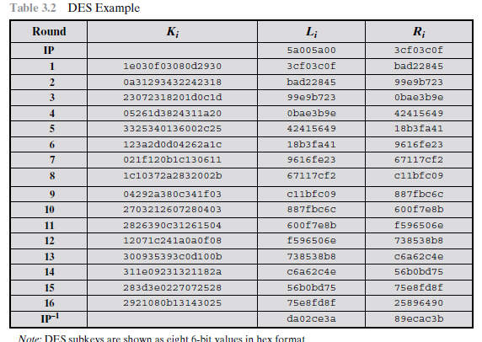
Results
shows the progression of the algorithm.

Slide 95
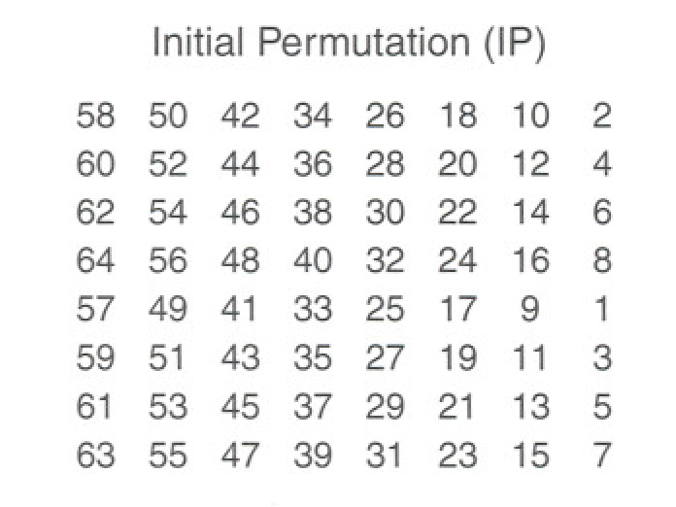
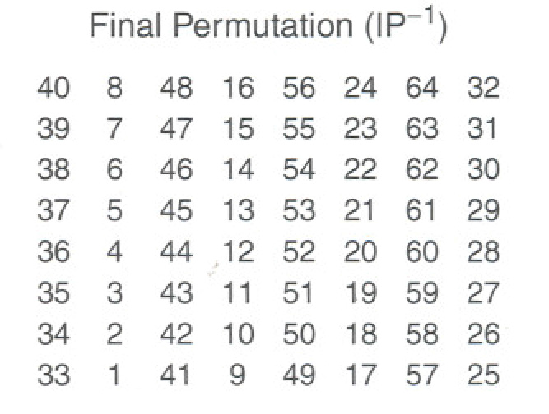
Permutation Tables for DES
Input bit 58 goes to output bit 1
Input bit 50 goes to output bit 2, …
Even bits to LH half, odd bits to RH half
Quite regular in structure (easy in h/w)

Slide 96
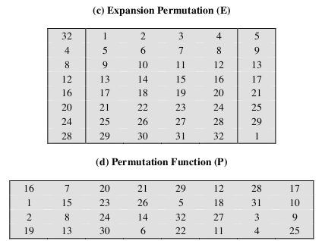
Permutation Tables for DES

Slide 97
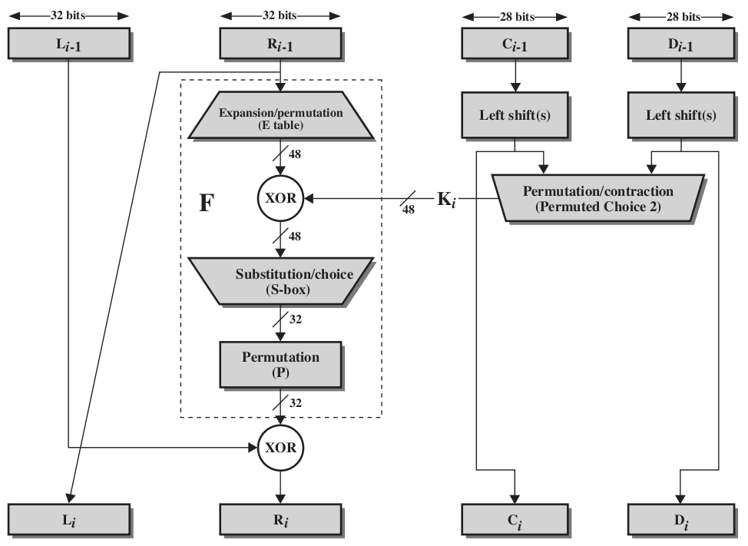
Single Round of DES Algorithm

Slide 98
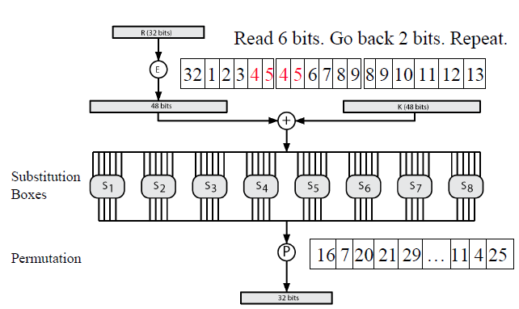
Calculation of F(R,K)

Slide 99
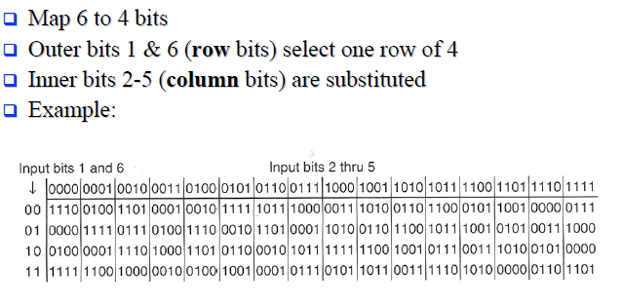
Substitution boxes

Slide 100
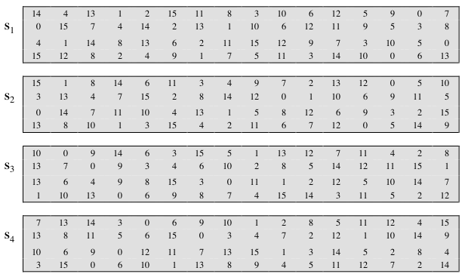
Definition of DES S-Boxes

Slide 101
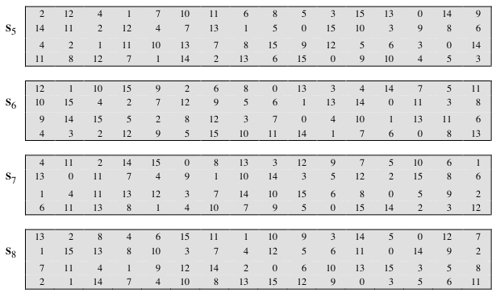
Definition of DES S-Boxes

Slide 102
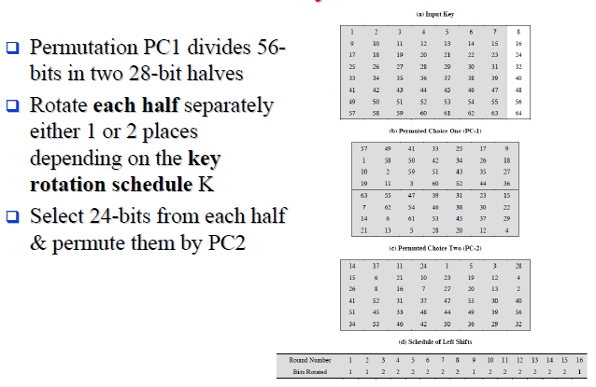
DES Key Schedule Calculation

Slide 103
The Avalanche Effect
Aim: small change in key (or plaintext) produces large change in ciphertext
Avalanche eect is present in DES (good for security)
Following examples show the number of bits that change in output when two dierent inputs are used, differing by 1 bit
Plaintext 1: 02468aceeca86420
Plaintext 2: 12468aceeca86420
Ciphertext difference: 32 bits
Key 1: 0f1571c947d9e859
Key 2: 1f1571c947d9e859
Ciphertext difference: 307
shows the result when the fourth
bit of the plaintext is changed, so that the plaintext is 12468aceeca86420.

Slide 104
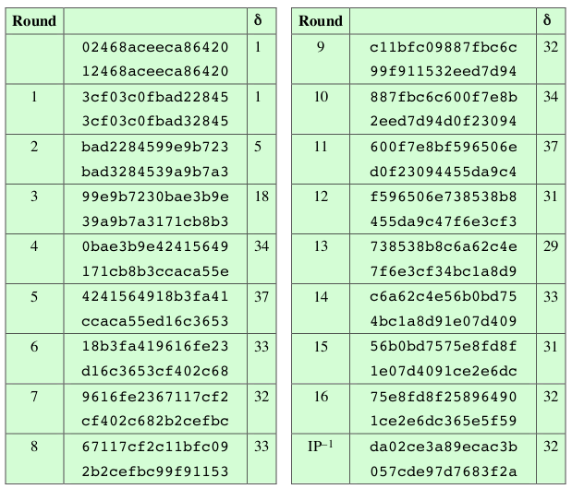
Avalanche Effect in DES: Change in Plaintext
The second column of the table shows the intermediate 64-bit
values at the end of
each
round for the two plaintexts.
The third column shows the number of bits that differ
between the two intermediate values.

Slide 105

Avalanche Eect in DES: Change in Key
shows a similar test using the original plaintext of with two keys that
differ in only the fourth bit position:

Slide 106
Concerns of DES
Key size and the nature of the algorithm
Although 64 bit initial key, only 56 bits used in encryption (other 8 for parity check)
2⁵⁶ = 7.2* 10¹⁶
1977: estimated cost $US20m to build machine to break in 10 hours
1998: EFF built machine for $US250k to break in 3 days
Today: 56 bits considered too short to withstand brute force attack
Recent offerings confirm this. Both Intel and AMD now offer hardware-based instructions to accelerate the use of AES. Test run on a contemporary multicore Intel machine resulted in an encryption rate of about half a billion encryptions per second.
3DES uses 128-bit keys

Slide 107


Slide 108
Concern of DES
The Nature of the DES Algorithm
Another concern is the possibility that cryptanalysis is possible by exploiting the characteristics of the DES algorithm
Because the design criteria for these S-boxes, and indeed for the entire algorithm, were not made public, there is a suspicion that the boxes were constructed in such a way that cryptanalysis is possible for an opponent who knows the weaknesses in the S-boxes.

Slide 109
Attacks on DES
Timing Attacks
Information gained about key/plaintext by observing how long implementation takes to decrypt
No known useful attacks on DES
Differential Cryptanalysis
Observe how pairs of plaintext blocks evolve
Break DES in 247 encryptions (compared to 255); but require 247 chosen plaintexts
Linear Cryptanalysis
Find linear approximations of the transformations
Break DES using 243 known plaintexts

Slide 110


Slide 111


Slide 112
Choosing F
Non-linerity in rough terms, the more difficult it is to approximate F by a set of linear equations, the more nonlinear F is.
A more stringent version of this is the strict avalanche criterion (SAC), which states that any output bit j of an S-box (see Appendix S for a discussion of S-boxes) should change with probability 1/2 when any single input bit i is inverted for all i, j.
Another criterion proposed in [WEBS86] is the bit independence criterion (BIC), which states that output bits j and k should change independently when any single input bit i is inverted for all i, j, and k.

Slide 113
DES Algorithm Design
DES was designed in private; questions about the motivation
of the design
S-Boxes provide non-linearity: important part of DES, generally considered to be secure
S-Boxes provide increased confusion
Permutation P chosen to increase diffusion

Slide 114
Multiple Encryption with DES
DES is vulnerable to brute force attack
Alternative block cipher that makes use of DES software/equipment/knowledge: encrypt multiple times with different keys
Options:
1. Double DES: not much better than single DES
2. Triple DES (3DES) with 2 keys: brute force 2112
3. Triple DES with 3 keys: brute force 2168

Slide 115

Double Encryption
For DES, 2 56-bit keys, meaning 112-bit key length
Requires 2111 operations for brute force?
Meet-in-the-middle attack makes it easier

Slide 116

Meet-in-the-Middle Attack

Slide 117

Triple Encryption

Slide 118

Other Symmetric Encryption Algorithms

Slide 119

Cryptanalysis on Block Ciphers

Slide 120
Multiple Encryption & DES
clear a replacement for DES was needed
theoretical attacks that can break it
demonstrated exhaustive key search attacks
AES is a new cipher alternative
prior to this alternative was to use multiple encryption with DES implementations
Triple-DES is the chosen form
Notes:
Given the potential vulnerability of DES to a brute-force attack,there has been considerable interest in finding an alternative. One approach is to design a completely new algorithm, of which AES is a prime example. Another alternative, which would preserve the existing investment in software and equipment, is to use multiple encryption with DES and multiple keys. We examine the widely accepted triple DES (3DES) approach.

Slide 121
Double-DES?
could use 2 DES encrypts on each block
C = E_{K2}(E_{K1}(P))
issue of reduction to single stage
and have “meet-in-the-middle” attack
works whenever use a cipher twice
since X = E_{K1}(P) = D_{K2}(C)
attack by encrypting P with all keys and store
then decrypt C with keys and match X value
takes O(2⁵⁶) steps
Notes:
The simplest form of multiple encryption has two encryption stages and two keys - Double-DES.
Have concern that there might be a single key that is equivalent to using 2 keys as above, not likely but only finally proved as impossible in 1992.
More seriously have the “meet-in-the-middle” attack, first described by Diffie in 1977. It is a known plaintext attack (ie have know pair (P,C), and attempts to find by trial-and-error a value X in the “middle” of the double-DES encryption of this pair, and chances of this are much better at O(2^56) than exhaustive search at O(2^112).

Slide 122
Triple-DES with Two-Keys
hence must use 3 encryptions
would seem to need 3 distinct keys
but can use 2 keys with E-D-E sequence
C = E_{K1}(D_{K2}(E_{K1}(P)))
nb encrypt & decrypt equivalent in security
if K1=K2 then can work with single DES
standardized in ANSI X9.17 & ISO8732
no current known practical attacks
several proposed impractical attacks might become basis of future attacks
Notes:
Triple-DES with two keys is a popular alternative to single-DES, but suffers from being 3 times slower to run. The use of encryption & decryption stages are equivalent, but the chosen structure allows for compatibility with single-DES implementations. 3DES with two keys is a relatively popular alternative to DES and has been adopted for use in the key management standards ANS X9.17 and ISO 8732. Currently, there are no practical cryptanalytic attacks on 3DES. Coppersmith notes that the cost of a brute-force key search on 3DES is on the order of 2^112 (=5*10^33) and estimates that the cost of differential cryptanalysis suffers an exponential growth, compared to single DES, exceeding 10^52.
There are several proposed attacks on 3DES that, although not currently practical, give a flavor for the types of attacks that have been considered and that could form the basis for more successful future attacks. See text for details.

Slide 123
Triple-DES with Three-Keys
although no practical attacks on two-key Triple-DES have some concerns
Two-key: key length = 56*2 = 112 bits
Three-key: key length = 56*3 = 168 bits
can use Triple-DES with Three-Keys to avoid even these
C = E_{K3}(D_{K2}(E_{K1}(P)))
has been adopted by some Internet applications, eg PGP, S/MIME

